Slide 1
Master class-2

Slide 2
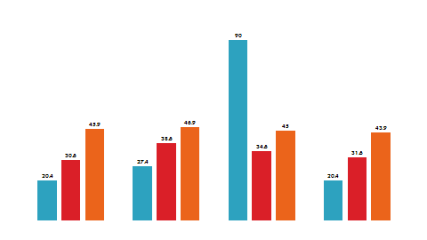
Today’s Agenda
Topics:
Java
Collections

Slide 3

Java Collecion
A framework as a unified architecture for representing and manipulating objects

Slide 4
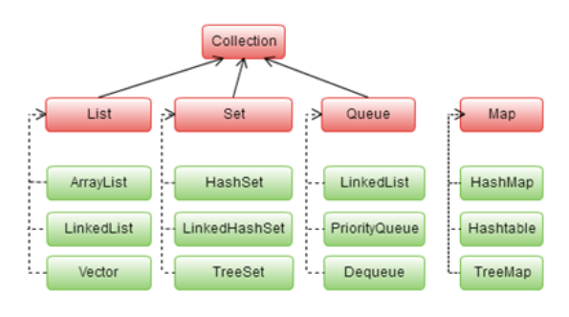
Collection Framework: About
Java platform includes a collections framework.
A collection is an object that represents a group of objects.
A collections framework is a unified architecture for representing and manipulating collections, enabling collections to be manipulated independently of implementation details.
Imported from java.util package

Slide 5
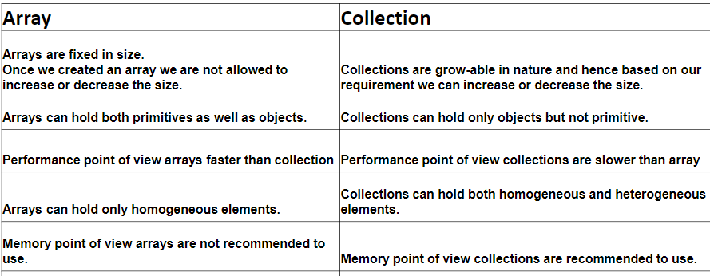
Array Vs Collection

Slide 6
Collection Framework: Advantages
Reduces programming effort by providing data structures and algorithms so you don't have to write them yourself.
Increases performance by providing high-performance implementations of data structures and algorithms.
Provides interoperability between unrelated APIs by establishing a common language to pass collections back and forth.
Reduces the effort required to learn APIs by requiring you to learn multiple ad hoc collection APIs.
Fosters software reuse by providing a standard interface for collections and algorithms with which to manipulate them.

Slide 7
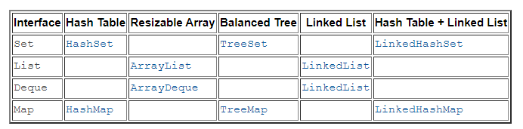
Collection: Implementations
Classes that implement the collection interfaces typically have names in the form of <Implementation-style><Interface>

Slide 8
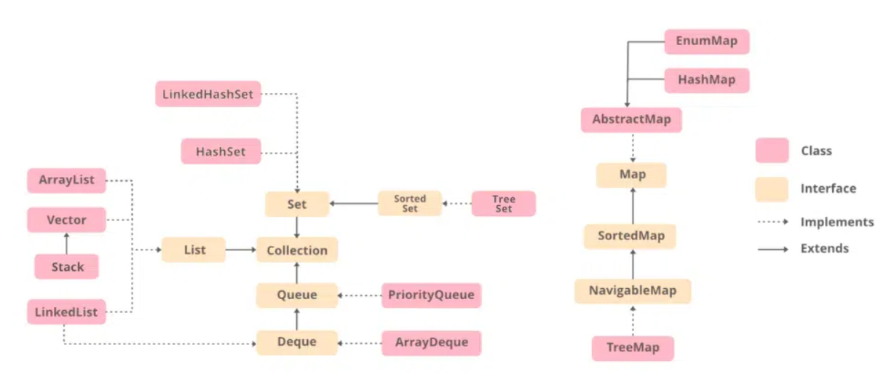
Collection: Implementations
Classes that implement the collection interfaces typically have names in the form of <Implementation-style><Interface>

Slide 9
Collection Framework: Concurrency
Concurrent-aware interfaces :
BlockingQueue / TransferQueue
BlockingDeque
ConcurrentMap/ConcurrentNavigableMap
Applications that use collections from more than one thread must be carefully programmed, known as concurrent programming.
The Java platform includes extensive support for concurrent programming.
Collections are so frequently used that various concurrent friendly interfaces and implementations of collections are included in collection APIs.
Concurrent-aware implementation classes in API:
LinkedBlockingQueue / ArrayBlockingQueue
PriorityBlockingQueue / DelayQueue
SynchronousQueue / LinkedBlockingDeque

Slide 10
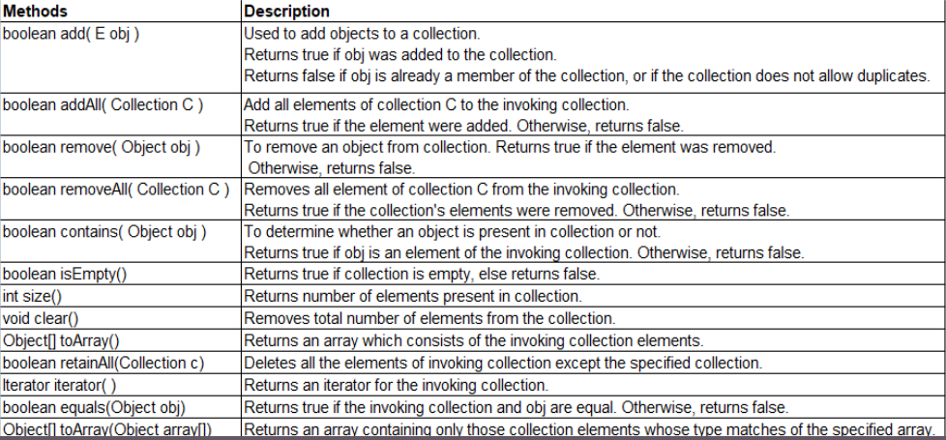
Collection: Methods
Collection gives in general methods for data structure implementations

Slide 11
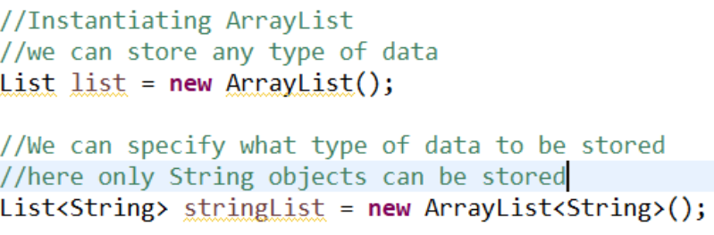
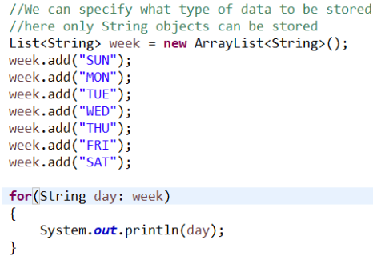
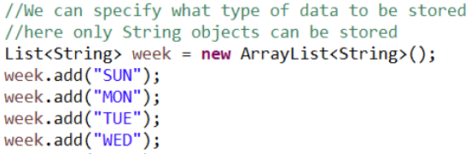
Collection: Example- List

Slide 12
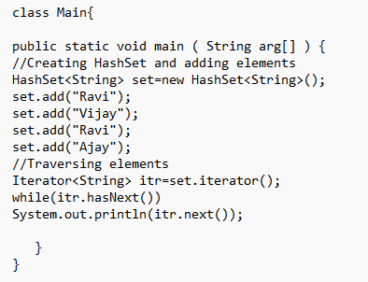
Collection: Example- Set

Slide 13
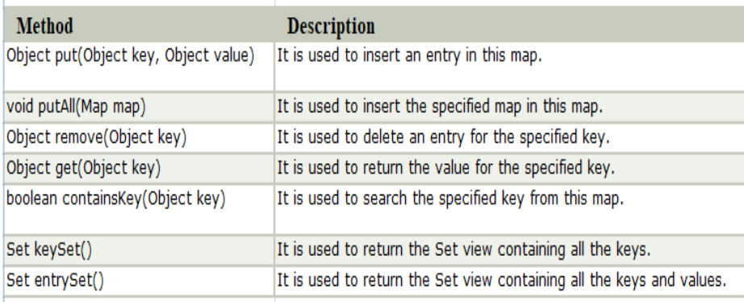
Collection Framework: Map
A Map is an object that maps keys to values.
A map cannot contain duplicate keys: Each key can map to at most one value.
The Java platform contains Map implementations:
HashMap
TreeMap
LinkedHashMap

Slide 14
Collection Framework: Map

Slide 15

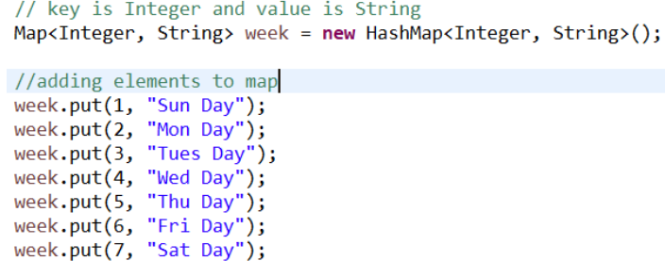
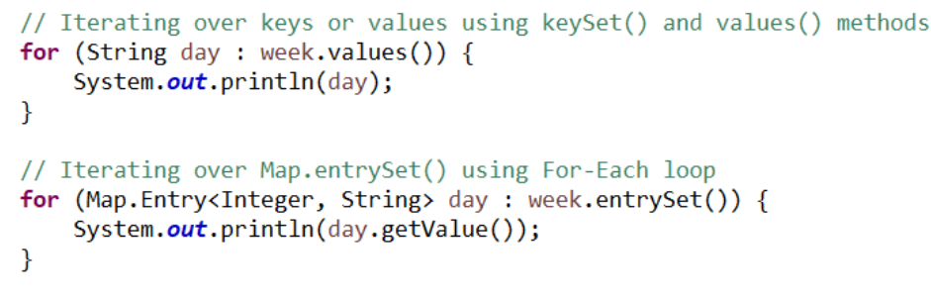
Collection Framework: Map

Slide 16
Collection Framework: Utility
Collections class in Java is one of the utility classes in Java Collections Framework.
The java.util package contains the Collections class in Java.
Java Collections class is used with the static methods that operate on the collections or return the collection.
All the methods of this class throw the NullPointerException if the collection or object passed to the methods is null.

Slide 17
Collection Framework: Utility
sort​(List<T> list) - sorts the specified list into ascending order, according to the natural ordering of its elements.
sort​(List<T> list, Comparator<? super T> c) - sorts the specified list according to the order induced by the specified comparator
shuffle​(List<?> list) - randomly permutes the specified list using a default source of randomness.
reverse​(List<?> list) - reverses the order of the elements in the specified list
max​(Collection<? extends T> coll) - returns the maximum element of the given collection, according to the natural ordering of its elements.
min​(Collection<? extends T> coll) - returns the minimum element of the given collection, according to the natural ordering of its elements.7

Slide 18
Collection Framework: Comparable
Java Comparable interface is used to order the objects of user-defined class.
This interface is found in java.lang package and contains only one method named compareTo(Object).
It provide single sorting sequence only i.e. you can sort the elements on based on single data member only.
For example it may be rollno, name, age or anything else.
public int compareTo(Object obj):
is used to compare the current object with the specified object.

Slide 19
Comparable interface
class Student implements Comparable<Student> {
int rollno;
String name;
int age;
Student(int rollno,String name,int age){
this.rollno=rollno;
this.name=name;
this.age=age; }
public int compareTo(Student st){
if(age==st.age)
return 0;
else if(age>st.age)
return 1;
else
return -1; }
}
public class TestSort{
public static void main(String args[]) {
ArrayList<Student> al=new ArrayList<Student>();
al.add(new Student(101,"Vijay",23));
al.add(new Student(106,"Ajay",27));
al.add(new Student(105,"Jai",21));
Collections.sort(al);
for(Student st:al){
System.out.println(st.rollno+" "+st.name+" "+st.age); }
}
}

Slide 20
Collection Framework: Comparator
Java Comparator interface is used to order the objects of user-defined class.
This interface is found in java.util package and contains 2 methods
compare(Object obj1,Object obj2)
equals(Object element).
It provides multiple sorting sequence i.e. you can sort the elements on the basis of any data member, for example rollno, name, age or anything else.
public int compare(Object obj1,Object obj2):
compares the first object with second object.

Slide 21
Comparator interface
class Student{ int rollno; String name; int age;
Student(int rollno,String name,int age){
this.rollno=rollno;
this.name=name;
this.age=age; }
}
class Simple{
public static void main(String args[]){
ArrayList al=new ArrayList();
al.add(new Student(101,"Vijay",23));
al.add(new Student(106,"Ajay",27));
al.add(new Student(105,"Jai",21));
System.out.println("sorting by age...");
Collections.sort(al,new AgeComparator());
Iterator itr2=al.iterator();
while(itr2.hasNext()) {
Student st=(Student)itr2.next();
System.out.println(st.rollno+" “
+st.name
+" "+st.age);
}
}
}
class AgeComparator implements Comparator{
public int compare(Object o1,Object o2){
Student s1=(Student)o1;
Student s2=(Student)o2;
if(s1.age==s2.age)
return 0;
else if(s1.age>s2.age)
return 1;
else
return -1; }
}

Slide 22
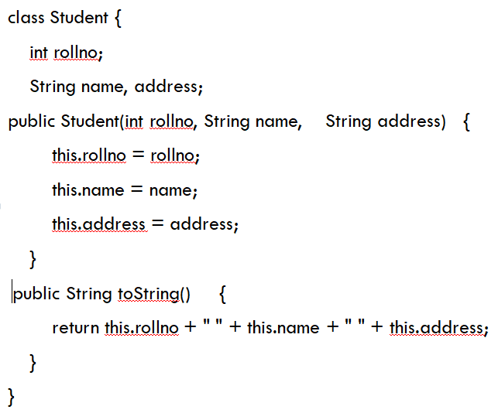
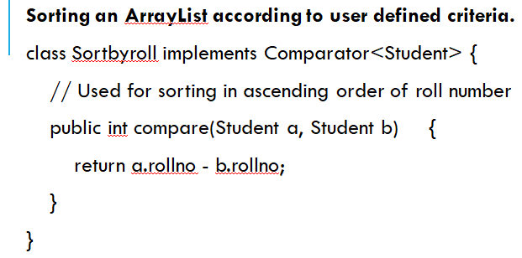
Collection Framework: Demo

Slide 23
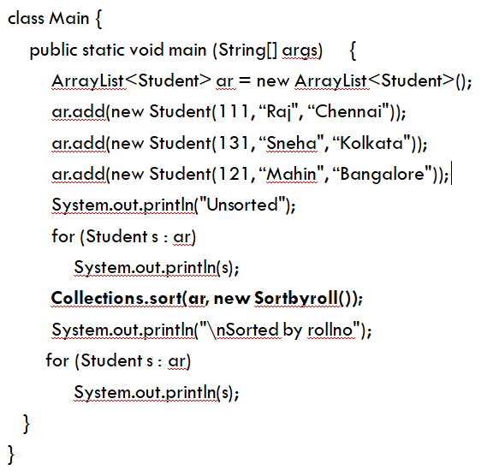
Collection Framework: Demo

Slide 24
Utilities : Arrays
The Arrays class of the java.util package contains several static methods that we can use to fill, sort, search, etc in arrays.
This class is a member of the Java Collections Framework and is present in java.util.arrays.

Slide 25
Utilities : Arrays – Demo-1
// Java program to demonstrate that we can print
// array elements in a single line
import java.util.Arrays;
public class Main {
public static void main(String[] args) {
int ar[] = {4, 6, 1, 8, 3, 9, 7, 4, 2};
// To print the elements in one line
System.out.println(Arrays.toString(ar));
}
}

Slide 26
Utilities : Arrays – Demo-2
// Java program to demonstrate that we can sort array elements in a single line
import java.util.Arrays;
public class Main {
public static void main(String[] args) {
int ar[] = {4, 6, 1, 8, 3, 9, 7, 4, 2};
// To sort a specific range of array in ascending order.
Arrays.sort(ar, 0, 4);
System.out.println("Sorted array in range" + " of 0-4 =>\n" + Arrays.toString(ar));
// To sort the complete array in ascending order.
Arrays.sort(ar);
System.out.println("Completely sorted order =>\n" + Arrays.toString(ar));
} }

Slide 27
Utilities : Arrays – Demo-3
// Java program to demonstrate that we can do binary search on array elements in a single line
import java.util.Arrays;
public class Main {
public static void main(String[] args) {
int ar[] = {4, 6, 1, 8, 3, 9, 7, 4, 2};
// Sort the complete array in ascending order so that Binary Search can be applied
Arrays.sort(ar);
// To search for a particular value(for eg 9) use binarysearch method of arrays
int index = Arrays.binarySearch(ar,9);
System.out.println("Position of 9 in sorted"+ " arrays is => \n" + index);
}
}

Slide 28
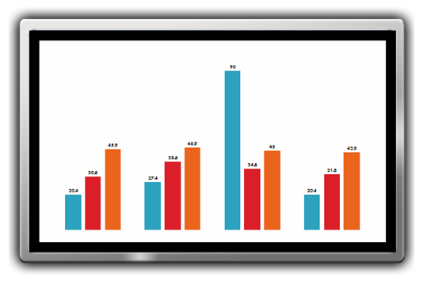
Collection Framework: Conclusion
The Java collections framework provides various data structures and algorithms that can be used directly.
We do not have to write code to implement these data structures and algorithms manually.
Our code will be much more efficient as the collections framework is highly optimized ☺ .

Slide 29
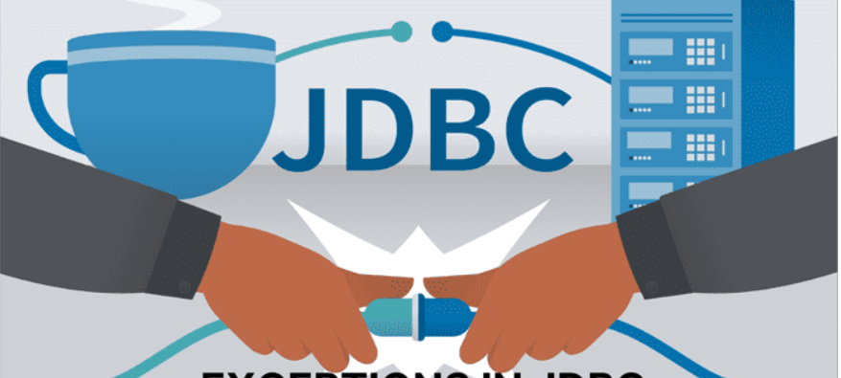
JDBC
[Java Database Connectivity]

Slide 30
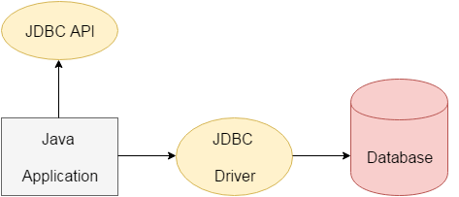
JDBC : Define
A Java API that can access any kind of tabular data, especially data stored in a Relational Database.
JDBC works with Java on a variety of platforms, such as Windows, Mac OS, and the various versions of UNIX.
This API consists of classes and interfaces written in Java.
It basically acts as an interface or channel between Java program and databases
It establishes a link between the two so that a programmer could send data from Java code and store it in the database for future use.

Slide 31
JDBC : APIs
A list of popular interfaces of JDBC API:
Driver interface
Connection interface
Statement interface
PreparedStatement interface
CallableStatement interface
ResultSet interface
ResultSetMetaData interface
DatabaseMetaData interface
RowSet interface
A list of popular classes of JDBC API:
DriverManager class
Blob class
Clob class
Types class

Slide 32
JDBC: DriverManager
Method | Description
1) public static void registerDriver(Driver driver): | is used to register the given driver with DriverManager.
2) public static void deregisterDriver(Driver driver): | is used to deregister the given driver (drop the driver from the list) with DriverManager.
3) public static Connection getConnection(String url): | is used to establish the connection with the specified url.
4) public static Connection getConnection(String url,String userName,String password): | is used to establish the connection with the specified url, username and password.
acts as an interface between user and drivers.
It keeps track of the drivers that are available and handles establishing a connection between a database and the appropriate driver.
methods of DriverManager class :

Slide 33
JDBC : Connection
is the session between java application and database.
is a factory of Statement, PreparedStatement,
and DatabaseMetaData
provide many methods for
transaction management like
commit(), rollback() etc.
1) public Statement createStatement(): creates a statement object that can be used to execute SQL queries.
2) public Statement createStatement(int resultSetType,int resultSetConcurrency): Creates a Statement object that will generate ResultSet objects with the given type and concurrency.
3) public void setAutoCommit(boolean status): is used to set the commit status.By default it is true.
4) public void commit(): saves the changes made since the previous commit/rollback permanent.
5) public void rollback(): Drops all changes made since the previous commit/rollback.
6) public void close(): closes the connection and Releases a JDBC resources immediately.

Slide 34
JDBC : Statement
provides methods to execute queries with the database.
The statement interface is a factory of ResultSet i.e. it provides factory method to get the object of ResultSet.
methods of Statement interface:
1) public ResultSet executeQuery(String sql): is used to execute SELECT query. It returns the object of ResultSet.
2) public int executeUpdate(String sql): is used to execute specified query, it may be create, drop, insert, update, delete etc.
3) public boolean execute(String sql): is used to execute queries that may return multiple results.
4) public int[] executeBatch(): is used to execute batch of commands.

Slide 35
JDBC : ResultSet
object of ResultSet maintains a cursor pointing to a row of a table.
Initially, cursor points to before the first row.
methods of ResultSet interface:
1) public boolean next(): | is used to move the cursor to the one row next from the current position.
2) public boolean previous(): | is used to move the cursor to the one row previous from the current position.
3) public boolean first(): | is used to move the cursor to the first row in result set object.
4) public boolean last(): | is used to move the cursor to the last row in result set object.
5) public boolean absolute(int row): | is used to move the cursor to the specified row number in the ResultSet object.
6) public boolean relative(int row): | is used to move the cursor to the relative row number in the ResultSet object, it may be positive or negative.

Slide 36
JDBC : Flow
Create the connections
After loading the driver, establish connections using :
Connection con = DriverManager.getConnection(url,user,password)
con: is a reference to Connection interface.
user – username from which your sql command prompt can be accessed.
password – password from which your sql command prompt can be accessed.
url : Uniform Resource Locator. It can be created as follows:
String url = “ jdbc:oracle:thin:@localhost:1521:xe”

Slide 37
JDBC : Flow
Create a statement
Once a connection is established you can interact with the database.
The JDBC Statement, CallableStatement, and PreparedStatement interfaces define the methods that enable you to send SQL commands and receive data from your database.
Use of JDBC Statement is as follows:
Statement st = con.createStatement();

Slide 38
JDBC : Flow
Execute the query
Query here is an SQL Query .
There are 2 types of query:
Query for updating / inserting table in a database :executeUpdate(sql query) method ofStatement interface
used to execute queries of updating/inserting .
Query for retrieving data :executeQuery() method of Statement interface
used to execute queries of retrieving values from the database.
This method returns the object of ResultSet that can be used to get all the records of a table.

Slide 39
JDBC : Flow
Close the connections
By closing connection, objects of Statement and ResultSet will be closed automatically.
The close() method of Connection interface is used to close the connection.
con.close();

Slide 40
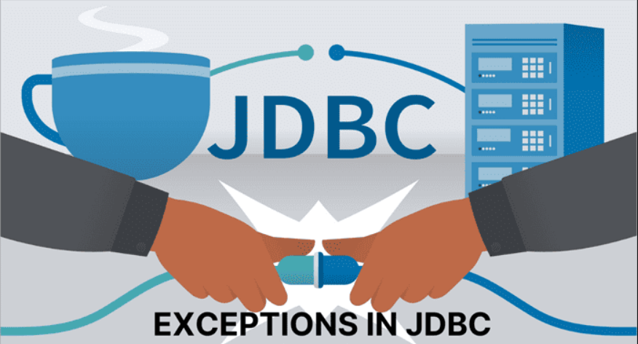
JDBC – Exception handling
[Java Database Connectivity]

Slide 41
JDBC : SQLException
In JDBC, we may get exceptions when we execute or create the query.
Exceptions that occur due to the Database or Driver come under SQL Exception.
Using Exception handling, we can handle the SQL Exception like we handle the normal exception ( try/catch or throws )
SQLException is available in the java.sql package.
It extends the Exception class which means that we can use the methods available in the Exception class in the SQLException class as well.

Slide 42
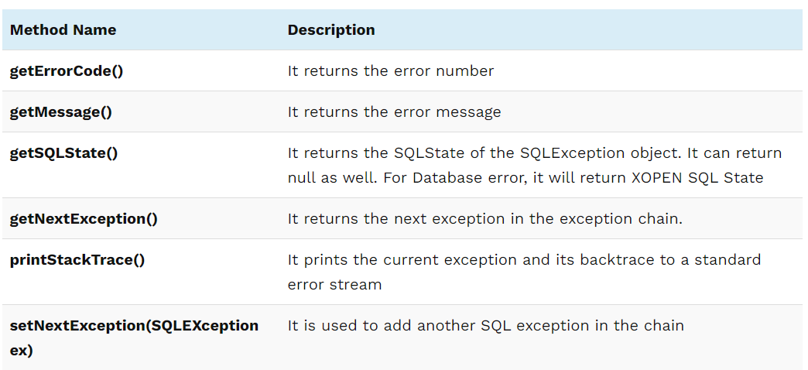
JDBC : SQLException Methods

Slide 43
JDBC : Code
public class Exception_Example {
public static void main(String[] args) throws ClassNotFoundException {
String update_query = "update employee_details set email='abc@gmail.com' where empNum1 = 101";
Class.forName("oracle.jdbc.driver.OracleDriver");
try(Connection conn = DriverManager.getConnection("jdbc:oracle:thin:system/pass123@localhost:1521:XE"))
{
Statement statemnt1 = conn.createStatement();
ResultSet rs1 =null;
statemnt1 = conn.createStatement();
int return_rows = statemnt1.executeUpdate(update_query);
System.out.println("No. of Affected Rows = "+ return_rows);
}
catch(SQLException sqe){
System.out.println("Error Code = " + sqe.getErrorCode());
System.out.println("SQL state = " + sqe.getSQLState());
System.out.println("Message = " + sqe.getMessage());
System.out.println("printTrace /n");
sqe.printStackTrace();
} } }

Slide 44
Widescreen Test Pattern (16:9)
Aspect Ratio Test
(Should appear circular)
4x3
16x9

